Slide 1
The Anishinaabek Cervical Cancer Screening Study
Reducing the incidence of cervical cancer in First Nations women by promoting uptake of cervical screening using culturally sensitive, community-derived educational strategies and self-sampling for HPV
This presentation has been prepared by Ingeborg Zehbe & Brenda Magajna © 2016 ACCSS. All rights reserved.

Slide 2
Presentation Overview
Background
History of the project
Pilot Study 2009
Larger Study with 10 First Nations – The Anishinaabek Cervical Cancer Screening Study
Ethical Space and Community Engagement
Study Design
PHASE 1 - Qualitative Data
Interviews with Community Health Care Providers
Sharing Circles with women in each community
Hiring of Community Based Research Assistants
Development and Implementation of Educational Strategies
PHASE 2: Quantitative Data - Screening Trial
Reflection meetings and follow-up visits to the communities
Community Update Gathering – October 2015
Community Update Report
Community Visits December 2015
Future Directions

Slide 3
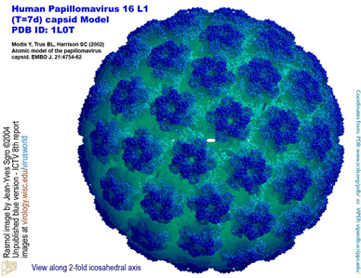
Cervical Cancer and Human Papillomavirus (HPV)
One of most common types of cancer in women worldwide
4th most commonly diagnosed and 4th for cancer-related deaths in women ¹
Primary cause: Infection with High Risk strains of HPV (HR-HPV)²
Preventable with regular screening and follow-up
Introduction of Pap Test in 1950s …
83% drop in cervical cancer deaths in Canada between 1952 and 2006 ³
However…
American Cancer Society. Global Cancer Facts & Figures 3rd Edition. Atlanta: American Cancer Society; 2015.
zur Hausen 2000 Papillomaviruses causing cancer: Evasion from host cell control in early events in carcinogenesis. Journal of the National Cancer Institute, 92, 690-698.
Dickenson et al 2012 Reduced cervical cancer incidence and mortality in Canada: National data from 1932 to 2006. BMC Public Health, 12, 992.

Slide 4
First Nations women are 2 – 20 times more likely to develop cervical cancer¹⁻³
Why?
Less access to Pap Screening?
Less comfortable having Pap test due to its invasive nature?
Other barriers?
How to increase screening rates?
Offer self-sampling for HPV instead of doing Pap tests?
…but is self-sampling for HPV a good alternative ? More about this later
Marrett & Chaudhry (2003) Cancer incidence and mortality in Ontario First Nations, 1968-1991 (Canada). Cancer Causes Control, 14, 259-68.
Decker et al (2015) Pap test use and cervical cancer incidence in First Nations women living in Manitoba. Cancer Prevention Research, 8, 49-55.
Colquhoun et al (2010) An investigation of cancer incidence in a First Nations community in Alberta, Canada, 1995-2006. Chronic Diseases in Canada, 30 (4), 135-40.

Slide 5
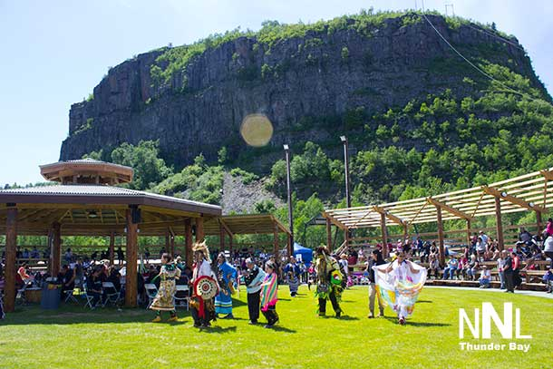
Pilot Study - Fort William First Nation 2009
Dr. Ingeborg Zehbe
Noticed that rates of cervical cancer are higher in First Nations women….
Wanted to use her knowledge of the link between HPV and cervical cancer to help reduce this
Pilot study with the Fort William First Nation (2009)
Goal: to increase cervical screening participation by offering self-sampling for HPV as an alternative to Pap testing.
Results:
87% of women felt that self-sampling was a better option that would lead to increased screening participation
Self-sample integrity was high (96%)
28.6% of samples were positive for HPV (both low and high risk types)
16.3% of samples were positive for HR-HPV (women were provided follow-up)
Conclusion:
Success of the pilot led to an invitation to the All Chief’s Meeting in 2010
Larger study to include 10 First Nations called the Anishinaabek Cervical Cancer Screening Study
Wood et al (2014) Using community engagement to inform and implement a community-randomized controlled trial in the Anishinaabek Cervical Cancer Screening Study. Frontiers in Oncology, 427.
Zehbe et al (2011) Feasibility of self-sampling and human papillomavirus testing for cervical cancer screening in First Nations women from Northwest Ontario, Canada: a pilot study .BMJ Open.

Slide 6
First Nation Communities with ACCSS
Animbiigoo Zaagi’igan Anishinaabek*
Biinjitiwaabik Zaaging Anishinaabek
Bingwi Neyaashi Anishinaabek*
Fort William First Nation
Kiashke Zaaging Anishinaabek
Long Lake #58 First Nation
Pays Plat First Nation
Pic Mobert First Nation
Red Rock Indian Band
Whitesand First Nation

Slide 7
The Anishinaabek Cervical Cancer Screening Study (ACCSS)
Long term goals:
To determine if the offer of self-sampling for HPV would increase levels of participation in screening
To engage directly with First Nations women about how to develop and implement sustainable and culturally acceptable screening programs

Slide 8
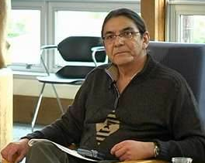
Creating ‘Ethical Space’ through Community Engagement
Concept of Ethical Space developed by First Nations scholar, Willie Ermine
ongoing dialogue and collaboration between the study team and the partner communities.
Embracing the principles of:
Partnership
Shared Control
Mutual Benefit and Respect
Builds bridges between
two disparate knowledge systems
and cultures
Public Health Research Approaches
Ethical Space Dialogue
Aboriginal Holistic Health Approaches

Slide 9
ACCSS – Community Engagement
The community leadership encouraged the research team members to:
Attend community events to build a better relationship with local women
Present at annual health fairs and cultural celebrations to raise awareness about the study and cervical cancer prevention in general
Develop a clearly outlined process for HPV testing that was to remain blinded at the community level to give optimum privacy to participants
Draft research agreements that could be tailored to the needs of the respective communities
Community Steering Committee – provided guidance on cultural safety
Publication Steering Committee – review of all publications, some writing

Slide 10
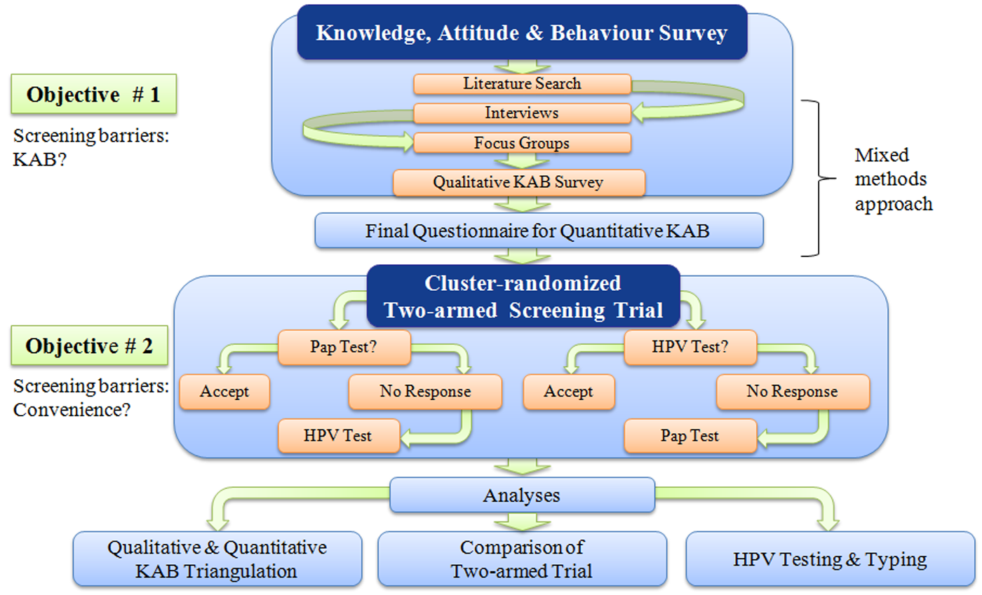
ACCSS - Study Design

Slide 11
Mixed Methods & Community Engagement
Qualitative
In 2011/2012, 16 interviews with health care professionals and 8 sharing circles with community members
Education
Pamphlet developed collaboratively with community partners
Communities developed educational strategies to recruit women
Quantitative
In January 2013, Community Based Research Assistants hired
From May 2013 to August 2014, cervical screening trial
Reveals need for education prior to offering screening
Educational strategies implemented during 2013
July 2014, Wool felting workshop

Slide 12
Qualitative Data: Interviews and focus groups
BARRIERS TO SCREENING:
Shortage and high turnover of appropriate health care providers
Geographic and transportation barriers
Education and socioeconomic inequalities
Need culturally appropriate services
Lack of a ‘notification system’ inviting/reminding eligible women to go for screening
NEED FOR EDUCATION:
The main reason women don’t participate in screening is lack of understanding
Community members who don’t understand why cervical screening is done are unlikely to have a Pap test.

Slide 13
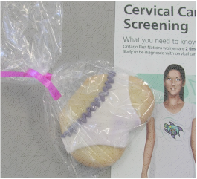
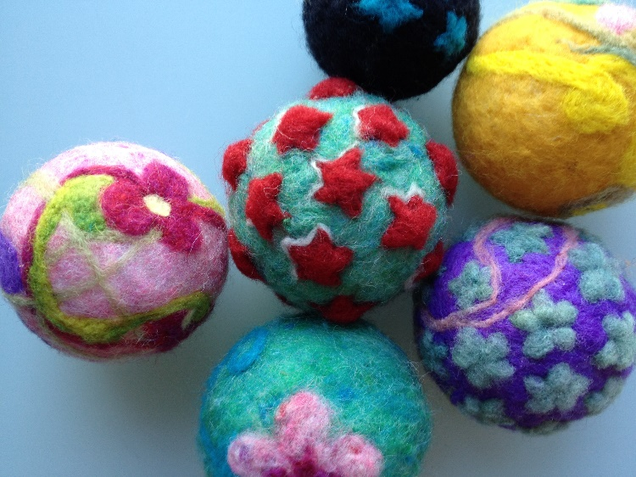
Educational Strategies
Lunch and Learn Sessions
Displays at Health Fairs
HPV Bingo
PiNk LaDys Tea PaRty
Underwear Cookies
Pamphlets
Cancer Awareness Day
Wool felting of HPV balls
Hands-on activities led to more dialogue!

Slide 14
Notes:
Created a brand with the study, based on input from the CSC and the work of Kevin Belmore (local artist originally from Gull Bay)
The concept of a dressed woman on the front of the pamphlet and an undressed woman on the inside sspeaks to the conservative nature of some First Nations women. Contributed by Aileen Malcolm.

Slide 15
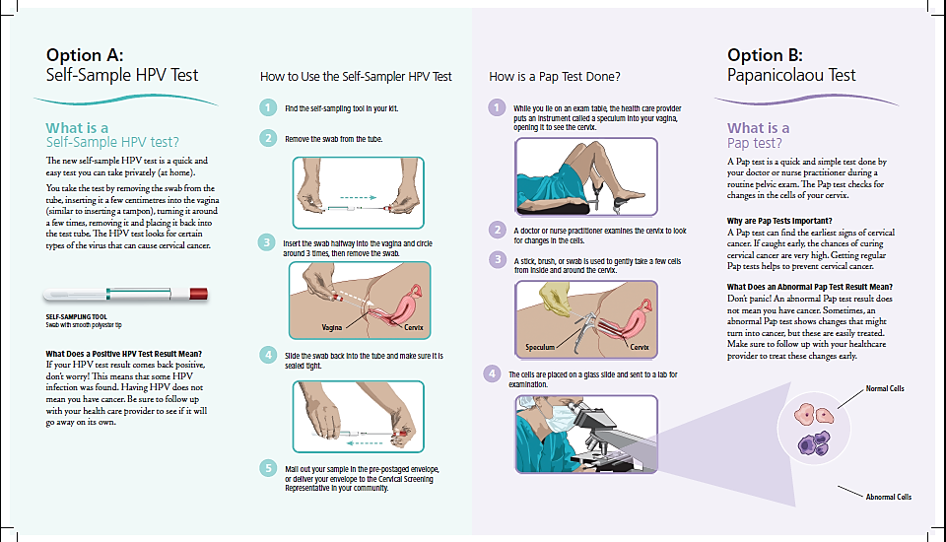
Notes:
Wanted to be informative through imagery, and still communicate information that emphasized how common HPV is and how a positive result does not mean cancer.

Slide 16
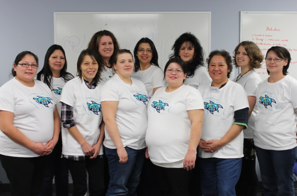
Community Based Research Assistants
Move away from “problem-focused” research to “change-based” research
Participants and facilitators are co-researchers

Slide 17
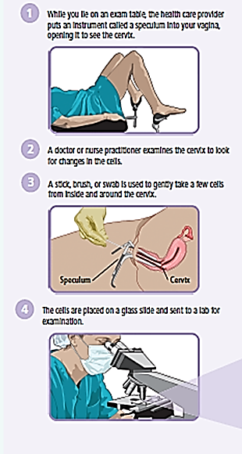
PHASE 2 - Quantitative Data The Screening Trial
Self-sampling
Pap testing
The 10 partner communities participated in an exploratory trial comparing the uptake of self-sampling for HPV with that of Pap testing.
All women who participated were asked to fill out a questionnaire
The communities were randomly assigned to Arm A (Intervention group) or Arm B (Control group)
In Arm A communities, women were offered screening by HPV self-sampling first and those who did not get screened by this method were later offered screening by Pap test
In Arm B communities, women were offered screening by Pap test first and those who did not get screened by this method were later offered screening by HPV self-sampling

Slide 18
Results of the Screening Trial
Twice as many women participated in screening when by self-sampling
One in five women (19%) tested positive for High Risk HPV
96% of the self-sampling tests were of adequate quality for DNA analysis
However, less than 25% eligible women participated in screening
Next steps: develop strategies to engage the “hard to reach” women
The results of the trial were all confidential, but follow up visits and reflection meetings allowed the sharing of general results

Slide 19
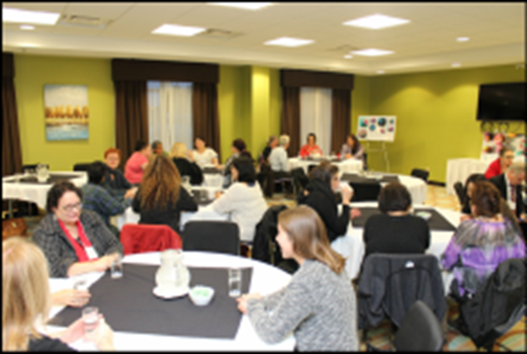
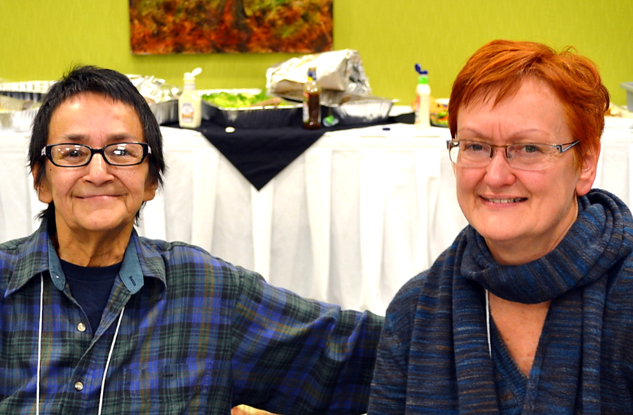
Community Update Gathering October 2015
2 day event at the local Holiday Inn
2 members from each First Nation
Stakeholders from Society of Obstetricians and Gynaecologists of Canada (SOGC) and Cancer Care Ontario (CCO)
Goals:
To share and report back the findings
To invite community feedback
Decide next steps
Sharing circle format worked well to encourage respectful discussion
All communities are eager to continue with the study

Slide 20
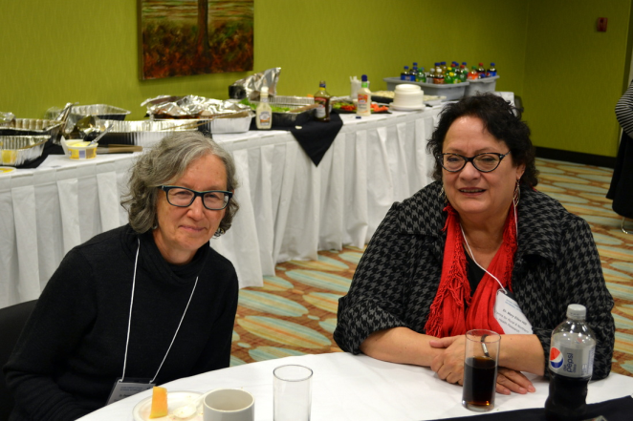
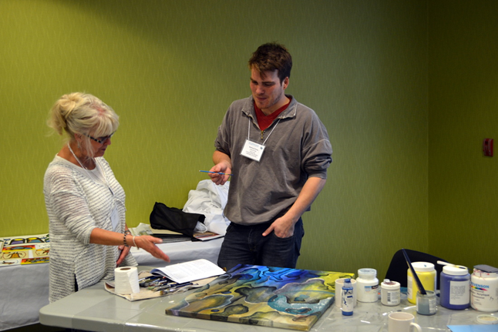
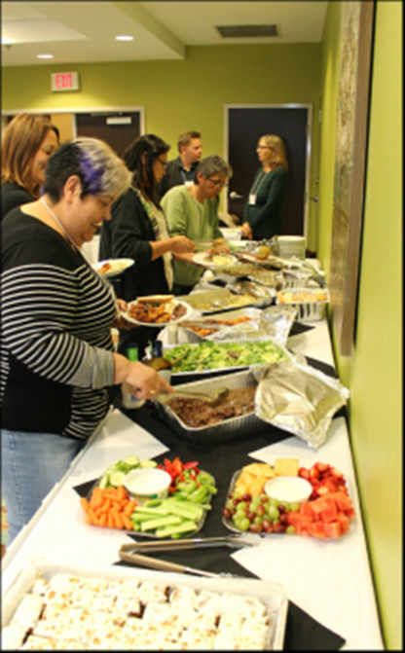
Community Update Gathering Photos

Slide 21
Community Update Report 2015
Draft report was emailed to community reps prior to and then distributed at the Community Update Gathering
Community members were asked for feedback and this was incorporated into the final version
Copies available online at:
www.accssfn.com

Slide 22
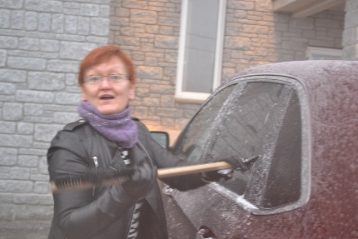
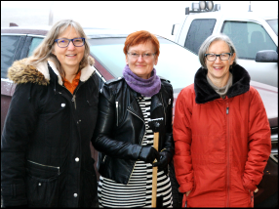
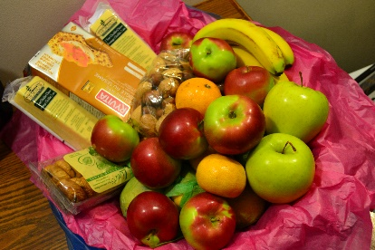
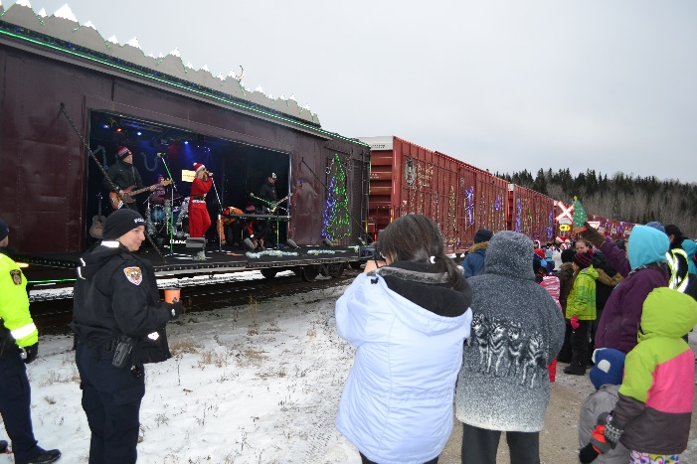
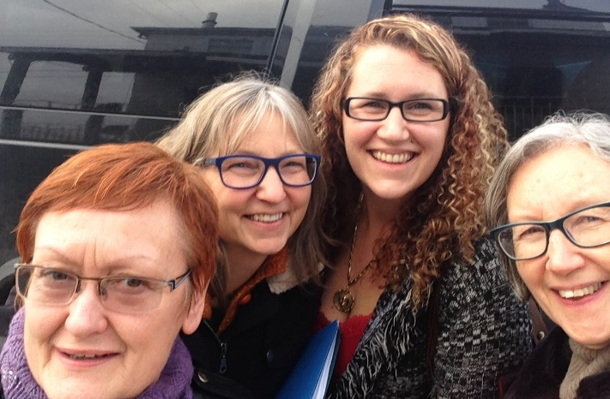
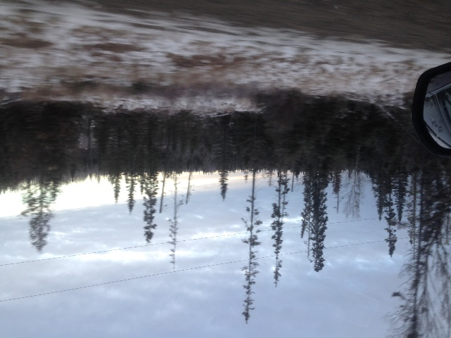
Community Visits December 2015
Visits to each community to
Discuss next steps…?
Determine needs specific to each community
Brainstorm ideas for future cervical screening educational strategies and sustainable plans

Slide 23
Future Directions
Currently applying for funding to move into the implementation stages
Community derived educational plans that can be maintained
Including new communities in Northern Alberta as Pilot study to assess transferability of process
Will only offer HPV testing
Assessing the effectiveness of particular educational plans to increase uptake of cervical screening by self-sampling for HPV
Recognize that creating awareness takes time – repeated education
www.accssfn.com
http://www.cancerscreening.gov.au/internet/screening/publishing.nsf/Content/future-changes-cervical

Slide 24
Acknowledgements
Thank you to the partner communities, and to all who have contributed to this work. Financial support was graciously provided by CIHR, TBRRI and Lakehead University.
The turtle logos for the Anishinaabek Cervical Cancer Screening were designed by Mr. Kevin Belmore from Kiashke Zaaging Anishinaabek.
This presentation has been prepared by Ingeborg Zehbe & Brenda Magajna © 2016 ACCSS. All rights reserved.

